Slide 1
Manifestation of corrosion: a key to control corrosion
Dr G H Thanki
Director & Principal Consultant
Corrosion Control & Monitoring Consultancy
Vadodara
www.corrosionawreness.com
Lecture delivered as course leader
During Two day Programme on
“Advanced Corrosion Management 2014”
Mumbai on 30th & 31st Jan 2014
Organized by
Indian Knowledge Center

Slide 2
WE WILL UNDERSTAND ABOUT…
Corrosion Manifestation – Schematic
Corrosion Manifestation Category
Uniform Corrosion
Localised Corrosion
Manifestation of Pits
Oxygen Pits
Pitting Factor
Effect of Certain Parameters on Initiation to pit
Crevice Corrosion
Galvanic Corrosion
Control of Thermo-Galvanic Corrosion
Dealloying
Intergranular Corrosion
Erosion-Corrosion: Cavitation: Fretting
Cavitation
Fretting Corrosion
Cracking Phenomena
Stress Corrosion Cracking
Corrosion Fatigue

Slide 3
FORMS OF CORROSION (IDENTIFY AS CORROSION APPEARS AND CONTROL)
Several basic forms of corrosion,
which itself it manifests,
are observed in corroded metals –
can be identified by mere visual observation.
Valuable information for the solution of corrosion problem can often be obtained through careful observation of the corroded test specimens or failed equipment

Slide 4
Corrosion Manifestation - Schematic

Slide 5
Pie Chart summary of 363 failures cases investigated in chemical industries

Slide 6
Corrosion Manifestation Category
Corrosion can be divided into three categories
Group I : Those, which can usually be
distinguished by the naked eyes
Group II : Those, which are more readily
recognized with the assistance
of supplementary means of examination.
Group III: Those which usually should be
verified by microscopy of one kind or
another (optical, scanning, electron, etc.).

Slide 7
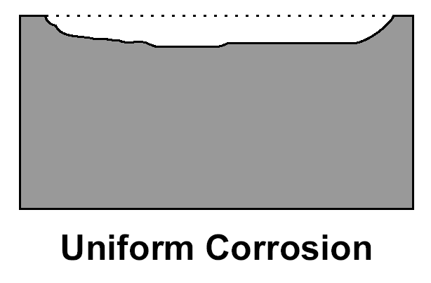
Uniform Corrosion (30% of Failures)
Group I
Those, which can usually be distinguished by the naked eyes
Uniform corrosion, as the name suggests, occurs over the majority of the surface of a metal at a steady and often predictable rate
Schematic
Actual

Slide 8
Uniform Corrosion
Technically this can be easily assessed by laboratory experiments, or even during service, and necessary allowance in thickness can be given to take care of the metal loss during service
For Example,
Knowing that a particular material has a general corrosion rate of 12 mpy, a corrosion allowance of 0.125” added to the thickness required for design condition will give about ten years’ life before corrosion encroaches upon the mechanical integrity of the vessel

Slide 9
Control of Uniform Corrosion
Uniform corrosion can be slowed or stopped by using the following SEVEN basic facts
1. Slow down or stop the movement of electrons
i. Coat the surface with a non-conducting medium such as paint, lacquer or oil
ii. Reduce the conductivity of the solution in contact with the metal an extreme case being to keep it dry. Wash away conductive pollutants regularly.
2. Apply a current to the material. (Cathodic Protection)
3. Slow down or stop oxygen from reaching the surface. Difficult to do completely but coating can help.

Slide 10
Control of Uniform Corrosion
4. Prevent the metal from giving up electrons by using a more corrosion resistant metal higher in the electrochemical series.
Use a sacrificial coating, which gives up its electrons more easily than metal being protected.
Apply cathodic protection.
Use inhibitors.
5. Select a metal that forms an oxide that is protective and stops the reaction
Use thicker materials for corrosion allow
Control and consideration of environment

Slide 11
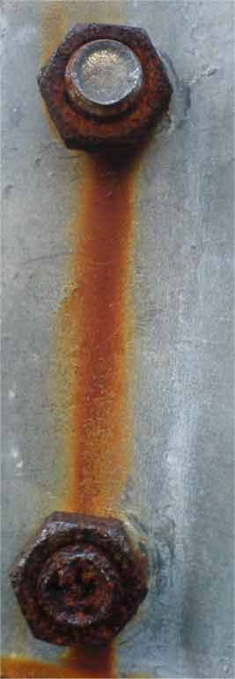
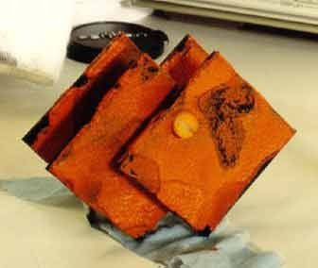
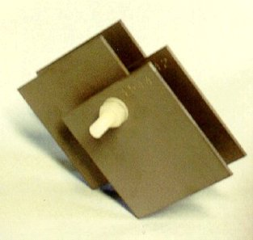
Surface after immersion in aerated water
UNIFORM CORROSION (RUSTING)
of a pair of steel nuts used to fasten a galvanized steel clamp on a street lamp post.
Surface exposed to deaerated water,
retained their metallic appearance with no visible corrosion (rust).

Slide 12
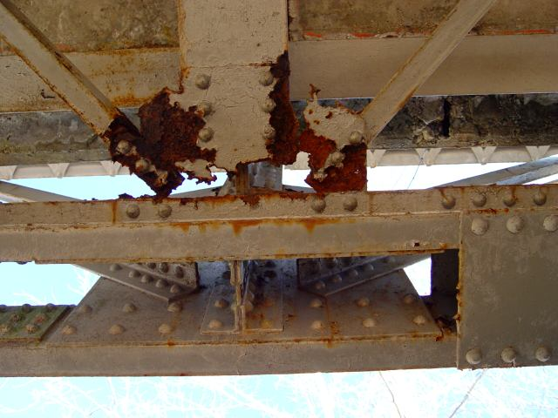
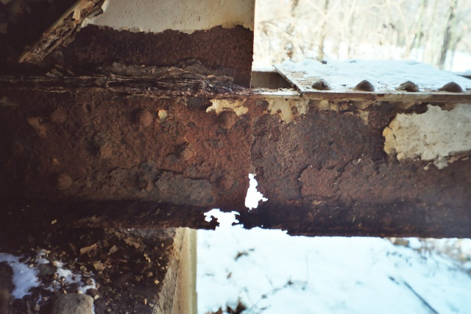
Perhaps the most serious structural problem is the RUST
that has nearly eaten away half the lower cord under the bridge
This gusset plate is nearly rusted through.

Slide 13
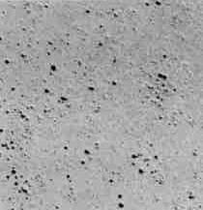
Localised Corrosion (70% of failures)
The consequences of localized corrosion can be a great deal more severe than uniform corrosion, generally because the failure occurs
without warning and after a surprisingly short period of use or exposure.
Pitting is one of the most destructive and
insidious forms of corrosion.
It causes equipment to fail because of perforation with only a small percent weight loss of the entire structure
Considering the number of failure incidents related to
corrosion in the chemical process industry, Pitting corrosion comes next to SCC

Slide 14
Manifestation of Pits
Sideway Pits
Trough Pits
Narrow, deep
ASTM – G 46
A STANDARD VISUAL CHART for
PITTING CORROSION RATING
Subsurface
Shallow, wide
Undercutting
Elliptical
Horizontal grain attack
Vertical grain attack

Slide 15
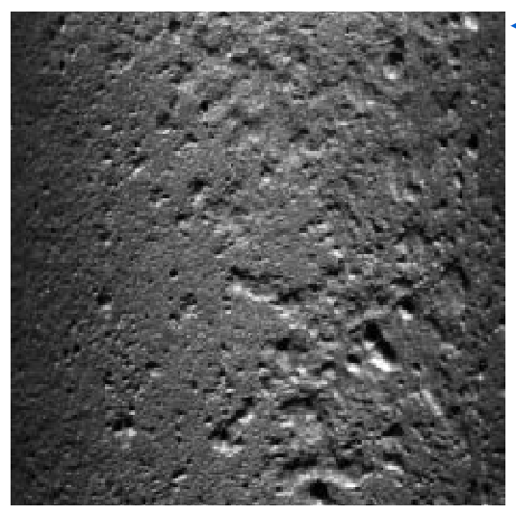
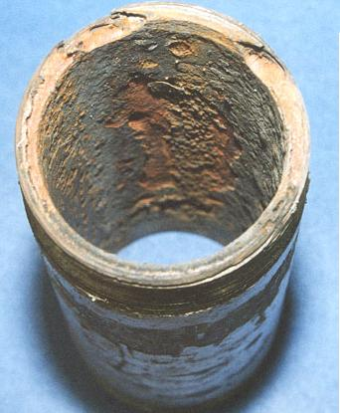
Oxygen Pits
Aggressive localized corrosion and loss of tube wall, most prevalent near
Economizer Feed Water Inlet on Operating Boilers
Flooded or non-drainable surfaces are most susceptible DURING OUTAGE PERIOD
Internal Surface Pitting in a Pipe

Slide 16
CO₂ pitting
H₂S pitting

Slide 17
"Pitting Factor"
There are several ways by which pits can be evaluated including pit size and density measurements
The most commonly used parameter is "Pitting Factor",
Deepest metal penetration
Average metal penetration of the total pits at the surface
1 Pitting Factor represents uniform corrosion
The larger the number, greater the depth of penetration.

Slide 18
Effect of Certain Parameters on Initiation to pit
Effect of Alloying on Pitting Resistance of Stainless Steel Alloys
Element | Effect on pitting resistance
Chromium | Increases
Nickel | Increases
Molybdenum | Increases
Silicon | Decreases; Increases when present with molybdenum
Titanium and Columbium | Decreases resistance in FeCl_{3;} other mediums no effect
Sulphur and Selenium | Decreases
Carbon | Decreases, especially in sensitised condition
Nitrogen | Increases
Velocity
Velocity, or increasing velocity, often decreases pitting attack
Metallurgical Variables
Mechanical & Surface Condition Variables
Severe cold working
Surface finish.Polished surface

Slide 19
Control Over Pitting Corrosion
1. Selecting a resistant material
2. Ensuring a high enough flow velocity of fluids in contact with the material or frequent washing
3. Control of the chemistry of fluids and use of inhibitors
4. Use of protective coating
5. Maintain the material’s own protective film.
Pits can be crack initiators in stressed components or those with residual stresses resulting from forming operations.
This can lead to Stress Corrosion Cracking.

Slide 20
Crevice Corrosion
Crevice Corrosion comes in action,
where the faying (i.e. adjacent, tightly joined) surfaces become depleted of oxygen, while adjacent areas are cathodic because of ready access of depolarising species
The contacting couple may consist of two metals, or a metal and a non-metal, such as an elastomeric gasketed surface

Slide 21
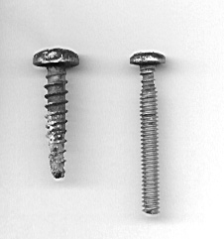
Crevice Corrosion on Screws
Exposed to water both under the head, and on the inside of the hull,
where it has thinned at both locations
The typical wasting of the shank right under the screw head

Slide 22
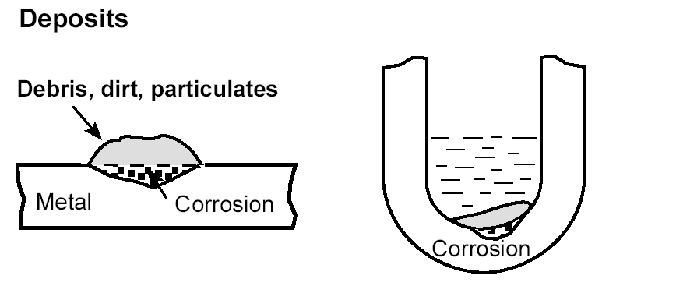
Crevice – Deposit – Gasket Corrosion
This type of attack is usually associated with small volumes of stagnant solutions. This can be caused by holes; gaskets surface deposits, and crevices under bolt and rivet heads.
As a result, this form of corrosion is called crevice corrosion or sometimes, deposit or gasket corrosion.

Slide 23
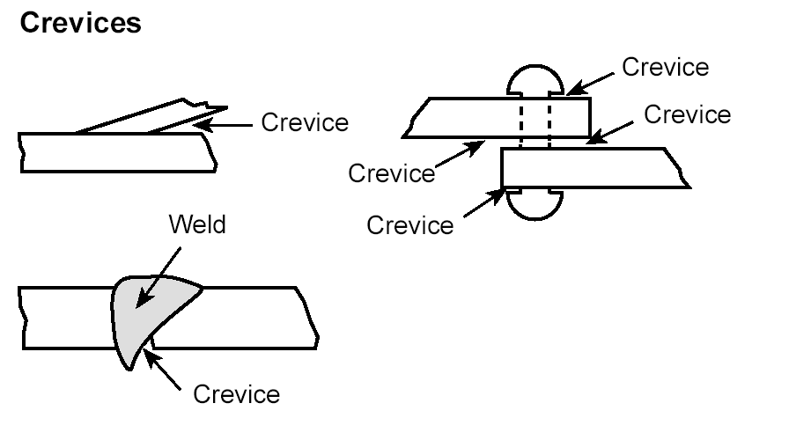
Crevices in Fabrication Process

Slide 24
Define- Crevice Design
To function as a corrosion site,
a crevice must be wide enough to permit liquid entry,
but sufficiently narrow to maintain a stagnant zone
For this reason,
crevice corrosion usually occurs at openings
a few thousands of an inch or less in width.
It rarely occurs within wide (e.g., 1/8 inch) grooves or slots.
Metals or alloys, which depend on oxide films or passive layers for corrosion resistance, are particularly susceptible to crevice corrosion.

Slide 25
Control of Crevice Corrosion
Close crevices in existing lap joints by continuous welding, caulking, or soldering.
Use welded butt joints instead of riveted joints in new equipment. Sound welds and complete penetration are necessary to avoid porosity and crevices on the inside (if welded from one side)
Design vessels for complete drainage; avoid sharp corners and stagnant areas. Complete draining facilitates washing and cleaning, tends to prevent solids from settling on the bottom of the vessel.
Inspect equipment and remove deposits frequently.
Remove solids in suspension early in the process or plant flaw sheet, if possible….

Slide 26
Control of Crevice Corrosion
Remove wet packing materials during long shutdowns
Provide uniform environment, if possible, as in the case of backfilling a pipeline trench
Use “solid”, non-absorbent gasket, such as ‘Teflon’, wherever possible.
Weld instead of rolling in tubes in tube sheets
Select resistant materials.

Slide 27
Control Crevice Corrosion
Break the electrical contact using plastic insulators or coating between the metals.
Select metals close together in the galvanic series.
Prevent ion movement by coating the junction with an impermeable material, or ensure environment is dry and liquids cannot trap
Select metals/alloys as close together as possible in the galvanic series
Avoid unfavourable area effect of a small anode and large cathode.
Avoid threaded joints for materials far apart in the galvanic series.
Install a third metal which is anodic to both metals in galvanic contact
Design the anode part for occasional easy replacement

Slide 28
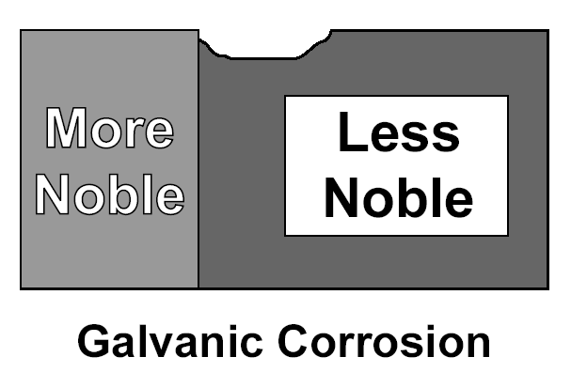
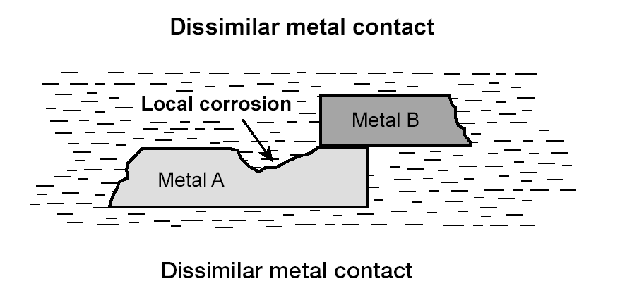
GALVANIC CORROSION
This can occur when two different metals are placed in contact with each other
and are caused by
the greater willingness
of one to give up electrons than the other.

Slide 29
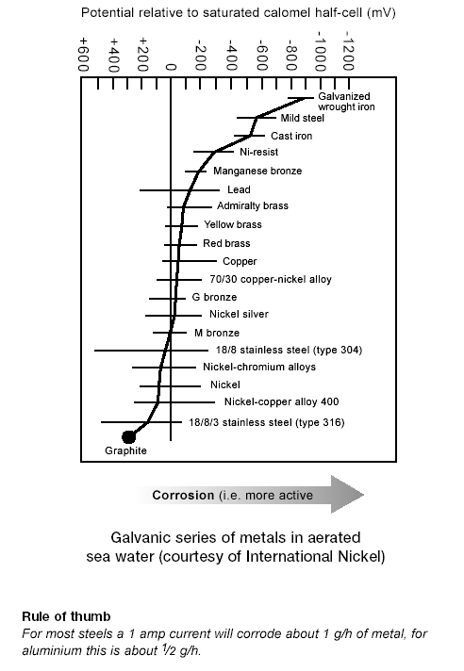
The emf series gives an idea about the thermodynamic possibility of galvanic corrosion through the electrode potential values of the coupled metals,
but
it is not very reliable since the reported potentials are sensitive to several other factors including
Composition of electrode,
Electrolyte,
Temperature,
Velocity,
pH etc…

Slide 31
GALVANIC CORROSION
Area Effect
Another important factor in galvanic corrosion is the area effect, or the ratio of anodic or cathodic areas.
An unfavourable area ratio:
Large Cathode and Small Anode.
(a)
a
(b)
(c)

Slide 32
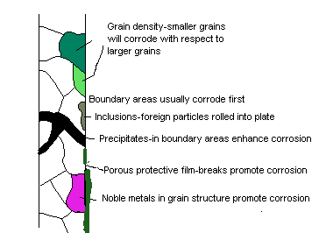
Galvanic Action Within Metal

Slide 33
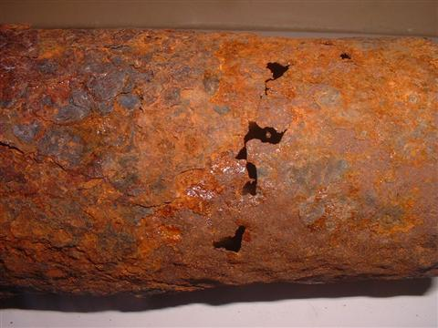
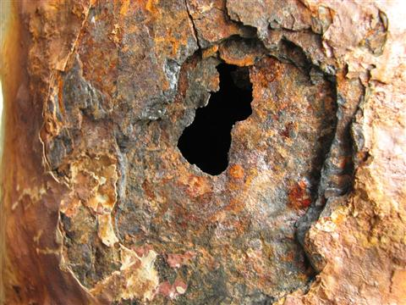
Control of Thermo-Galvanic Corrosion
Avoid uneven heating, cooling and formation of hot spots.
Design layout to prevent adverse effect of one component on the other.
Provide for continuity of insulation or lining.
Prevent by design access of differentially heated or cooled liquids from exterior sources

Slide 34
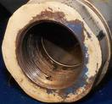
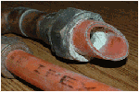
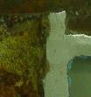
Dealloying
Group II
Those, which are more readily recognized with the assistance of supplementary means of examination.
It results from the fact that the components of the alloy corrode at different rates.
Identification
Dealloying is normally detectable as a colour change.
Brasses will turn from yellow to red
Cast iron from silvery gray to dark gray.
Gray iron that has suffered graphitic corrosion can be cut with a penknife.

Slide 35
Combination of Alloys and the Environment Subject to Dealloying and Elements Preferentially Removed
Alloy | Environment | Element removed
Brasses | Many Waters, especially under Stagnant conditions | Zinc (dezincification)
Gray iron | Soils, many waters | Iron (graphite corrosion
Aluminum bronzes | HF, acids containing chloride ions | Aluminium
Silicon bronzes | High temperature steam and acidic species | Silicon (desiliconification )
Tin bronzes | Hot brine or steam | Tin (destannification )
Copper nickels | Copper nickels | Copper nickels

Slide 36
Control - Dealloying
Coating the material
Reducing the aggressiveness of the environment
Use of cathodic protection
Select metals/alloys that are more resistant to dealloying
e.g., Inhibited brass is more resistant to dezincification that alpha brass
Ductile iron is more resistant to graphitic corrosion than gray cast iron.

Slide 37
Intergranular Corrosion
This is preferential attack of the grain boundaries of the crystals that form the metal.
It is caused by the physical and chemical differences between the centers and edges of the grain.
Grain boundary effects are of little or no consequence in most applications of metals.
If a metal corrodes, uniform attack results since grain boundaries are only slightly more reactive than the matrix.
However, under certain conditions grain interfaces are very reactive and intergranular corrosion results.

Slide 38
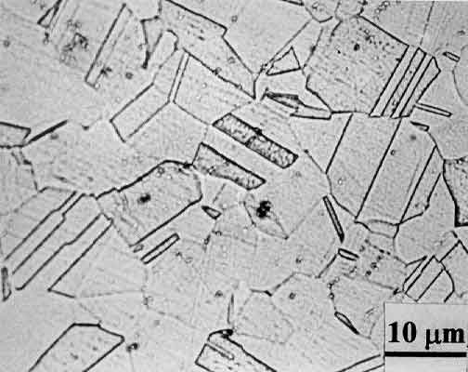
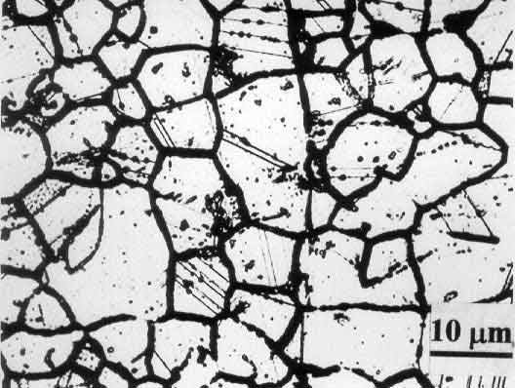
Intergranular Corrosion
Normalized microstructure
Sensitized microstructure
THE MICROSTRUCTURE OF AISI 304 STAINLESS STEEL.
Sensitized Structure is susceptible to intergranular corrosion or intergranular stress corrosion cracking.

Slide 39
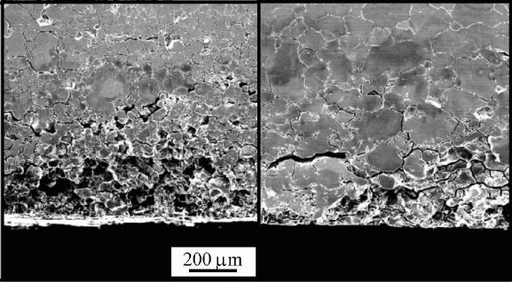
AISI
304
Grain De-cohesion Due to Intergranular Corrosion

Slide 40
Control for Austenitic Stainless Steels
(1) Employing high-temperature solution heat treatment, commonly termed quench-annealing or solution-quenching,
(2) Adding elements that are strong carbide formers (called stabilizers),
(3) Lowering the carbon content to below 0.03%.
(4) Addition of alloying Elements. Intergaranular attack by steam at 200⁰ to 300⁰ C on pure aluminium can be minimized by the addition to aluminium by copper, nickel and silicon as alloying elements.
(5) Adjustment of alloying elements. To minimize the formation of intermetallic phases, sigma and chi in stainless steels, the concentration of the alloying elements can be readjusted. In the case of Alloy C-276, minor alloying elements have been removed to minimize the formation of the molybdenum-rich phase to make Alloy C-4.

Slide 41
Erosion-Corrosion: Cavitation: Fretting
Erosion-corrosion is attack accelerated by high velocity flow, either washing away protective films or mechanically disturbing the metal itself. The true nature of the attack, may require
supplementary microscopy, despite the characteristic flow pattern visible to the naked eyes
Surface damage by Erosion, Cavitation or Fretting is often difficult to identify. There are features of each Damage Mode that make them subject to confusion.
The differences in methods for alleviating the severity of damage, it is important that the mode of damage be correctly identified in the failure analysis.

Slide 42
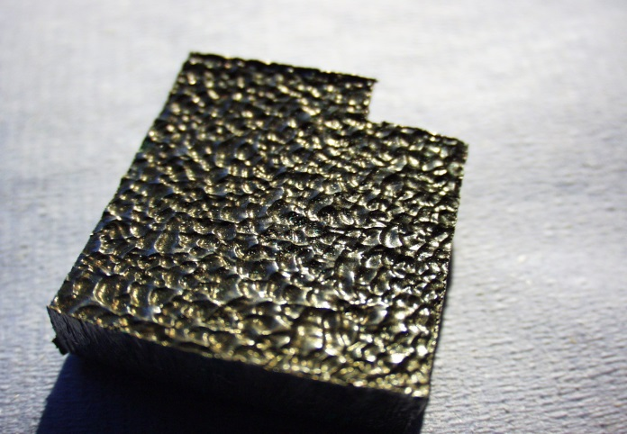
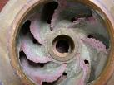
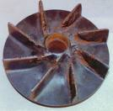
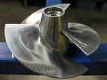
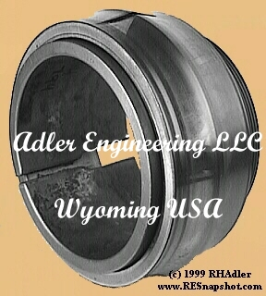
Erosion-Corrosion: Cavitation: Fretting
Erosion-corrosion and Cavitation are associated with flowing fluids.
Fretting associated with surface contact and small relative motions between the two contacting surfaces.
Erosion -corrosion
Cavitation
Fretting

Slide 43
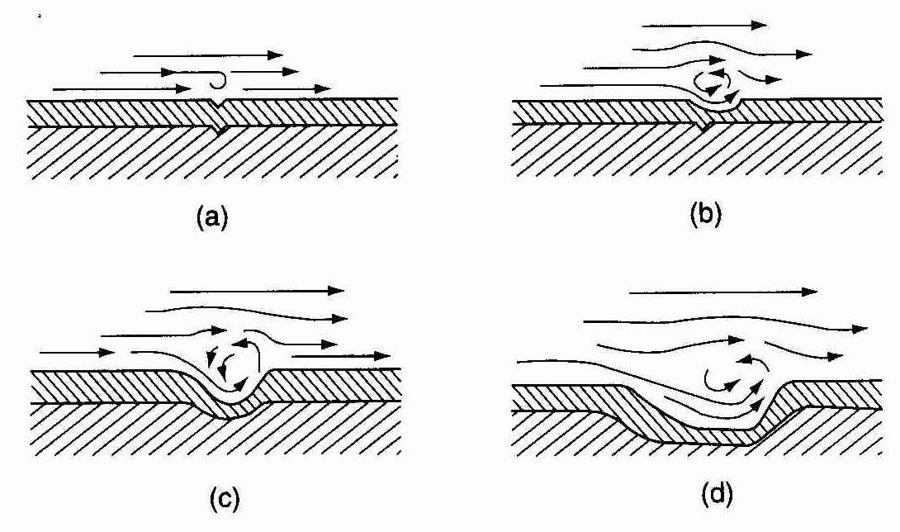
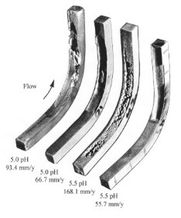
Erosion-Corrosion
Progressive Stages of Erosion-Corrosion

Slide 44
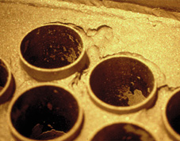
CARBON STEEL TUBE-SHEET, PART OF A SODA ASH EVAPORATOR UNIT.
SUFFERED EROSION-CORROSION IN TURBULENT AREAS

Slide 45
Erosion – Corrosion (Control)
Five methods of prevention or minimization of damage due to erosion corrosion are used.
In order of importance or extent of use,
(1) Better materials
(2) Design
(3) Alteration of the environment
(4) Coatings
(5) Cathodic protection.

Slide 46
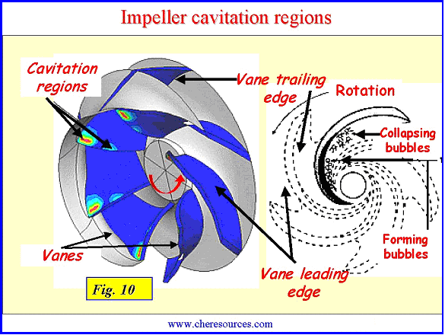
Cavitation
Cavitation is a special form of erosion corrosion caused by the collapse of bubble formed at areas of bubbles formed at areas of low pressure in a flowing stream.
Cavitation damage has a characteristic rounded crater effect when viewed at high magnification

Slide 47
Cavitation Damage (Preventive Measures)
In general, cavitation damage can be prevented by the techniques used in preventing erosion corrosion
Changing design to minimize hydrodynamic pressure differences in process flow streams
Smooth finishes on pump impellers and propellers
Coating metallic parts with resilient coatings such as rubber and plastic
Cathodic protection

Slide 48
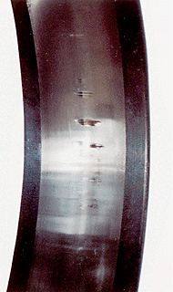
Fretting Corrosion
Fretting corrosion is also called
friction oxidation, wear oxidation, chafing and false brinelling.
It has been observed in engine components, automotive parts, bolted parts, and other machinery.

Slide 49
Fretting Corrosion (preventive remedial measures)
(1)Lubricate with low-viscosity, high-tenacity oils and greases which also tends to exclude oxygen.
(2)Increase the hardness of one or both of the contacting materials may be by shot-pinning or cold-working
(3) Increase friction between mating parts by roughening the surface. Often, bearing surface, which will be subjected to vibration during shipment are coated with lead to prevent fretting corrosion. When the bearing is placed in service, the lead coating is rapidly worn away.
(4)Use gaskets to absorb vibration and to exclude oxygen at bearing surfaces
(5)Increase load to reduce slip between mating surfaces

Slide 50
Cracking Phenomena
Group III
Any cracking type failure should be diagnosed using optical microscopy.
A scanning electron microscope is a valuable tool for differentiating the more obscure form of attack, such as
INTERGRANULAR SCC, and TRANSGRANULAR SCC from corrosion fatigue.
These include both corrosion fatigue, a mechanical phenomenon enhanced by non- specific corrosive environments, and environmental cracking, in which a brittle failure is induced in an otherwise ductile material under tensile stress in environment specific for the alloy system.
ENVIRONMENTAL CRACKING is a broad category and should embrace true stress corrosion cracking, hydrogen induced cracking of various kinds, and liquid metal cracking.

Slide 51
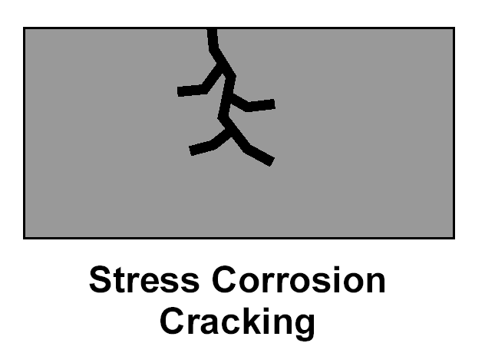
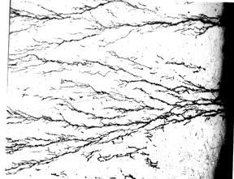
Stress Corrosion Cracking
Stress corrosion cracking is a brittle failure mode in an otherwise ductile metal, resulting from the combined action of a Tensile Stress and a Specific Corrosive Environment.
Stress corrosion cracks give the appearance of a
brittle mechanical fracture but they are the result of local corrosion process

Slide 52
Stress Corrosion Cracking (Stress Effects)
These stresses may be due to any source like:
Applied, Residual, Thermal, or Welding
welded steels contain residual stresses near the yield point.
Corrosion products have been shown to be another source of stress.
Corrosion products in constricted regions can
generate stresses up to 10,000 lb/in².

Slide 53
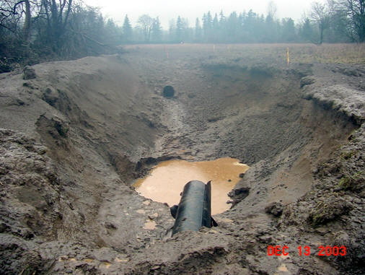
Gas Pipeline SCC - Catastrophic Rupture
Williams Pipeline, 13th December 2003
Gas Pipeline

Slide 54
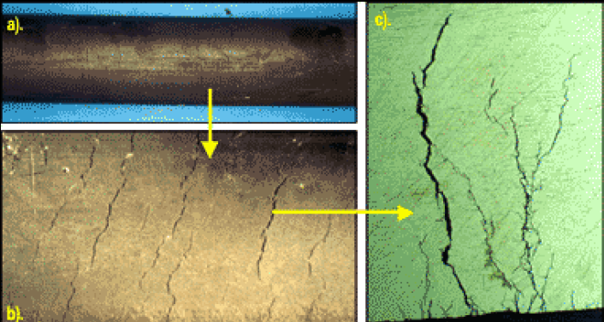
Chloride SCC Cracking On Pipe

Slide 55
Stress Corrosion Cracking(oxidizing species )
The presence of oxidizers often has a pronounced influence on cracking tendencies.
The presence of dissolved oxygen or other oxidizing species is critical to the cracking of austenitic stainless steels in chloride solutions
If the oxygen is removed cracking will not occur.
Stress-corrosion cracking of steel is frequently reported in
hydrogen sulphide solutions and cyanide containing solutions
These failures are undoubtedly due to Hydrogen Embrittlement rather than stress-corrosion cracking.

Slide 56
Stress Corrosion Cracking (Metallurgical Factors)
Average chemical composition,
Preferential orientation of grains,
Composition,
Distribution of precipitates,
Dislocation interactions, and
Progress of the phase transformation
affect the susceptibility to stress-corrosion cracking
These factors further interact with the Environment composition

Slide 57
Stress Corrosion Cracking (Control)
(1)Reduce the over all stress level and design out stress concentrations.
(2)Selection of a suitable material not susceptible to the environment
(3)Design to minimize thermal and residual stresses
(4)Develop compressive stresses on the surface of the material
(5)Use of suitable protective coating
(6)Application of cathodic protection to the structure with an external power supply or consumable anodes

Slide 58
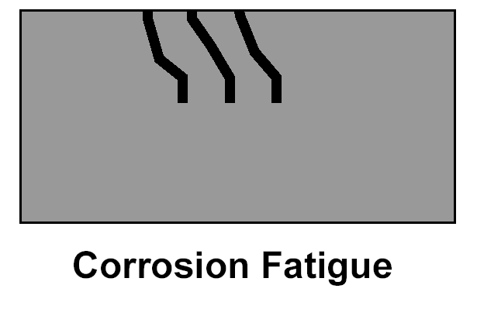
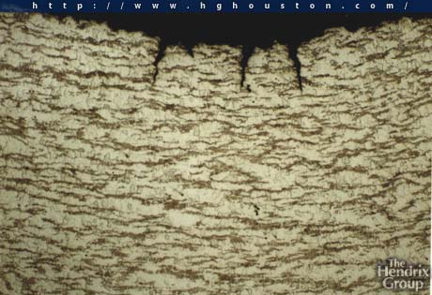
Corrosion Fatigue
Corrosion fatigue is defined as the reduction of fatigue resistance due to the presence of a corrosive medium.
Thus, corrosion fatigue is not defined in terms of the appearance of the failure, but in terms of mechanical properties.
Corrosion Fatigue Cracks
In AISI 1020 Steel In
Oil And Gas Downhole Service

Slide 59
Corrosion-Fatigue (Control)
Coating the material
Good design that reduces stress concentration
Avoiding sudden changes of section
Removing or isolating sources of cyclic stress

Slide 60
Epilogue
ON THE BASIS OF INTERACTION
WE COULD INFER
THAT IN MOST CASES
THE UNAIDED EYE IS SUFFICIENT,
BUT SOMETIMES MAGNIFICATION IS HELPFUL OR MANDATORY
ALL FORMS ARE UNIQUE,
BUT ALL OF THEM ARE MORE OR LESS INTERRELATED.
VALUABLE INFORMATION FOR THE SOLUTION OF A CORROSION PROBLEM CAN OFTEN BE OBTAINED THROUGH
CAREFUL OBSERVATION
OF THE CORRODED TEST SPECIMENS OR FAILED EQUIPMENT.
Manifestation of Corrosion is the Clue of the Control

Slide 61
So, we learnt about…
Corrosion Manifestation – Schematic
Corrosion Manifestation Category
Uniform Corrosion
Localised Corrosion
Manifestation of Pits
Oxygen Pits
Pitting Factor
Effect of Certain Parameters on Initiation to pit
Crevice Corrosion
Galvanic Corrosion
Control of Thermo-Galvanic Corrosion
Dealloying
Intergranular Corrosion
Erosion-Corrosion: Cavitation: Fretting
Cavitation
Fretting Corrosion
Cracking Phenomena
Stress Corrosion Cracking
Corrosion Fatigue

